Slide 1
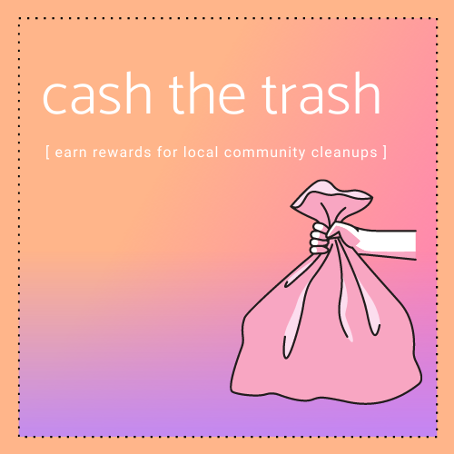
cash the trash
Demo Day Presentation
June 22, 2021
Nagham Hesham Mohamed Eldegwy, Rachel Ralph,
Ymma Villacastin, Kira Wiese, Hailan Xu

Slide 2
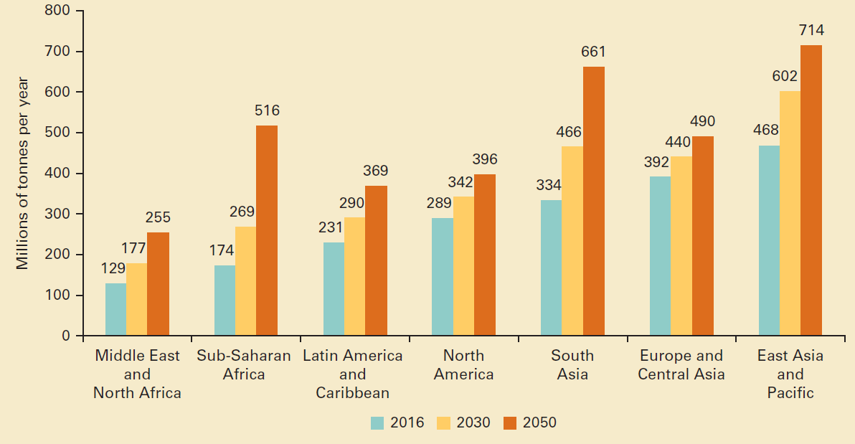
Projected waste generation, by region (millions of tonnes/year)¹
At least 33% of global waste is not managed in an environmentally safe manner!
¹ “Trends in Solid Waste Management.” The World Bank, datatopics.worldbank.org/what-a-waste/trends_in_solid_waste_management.html.

Slide 3
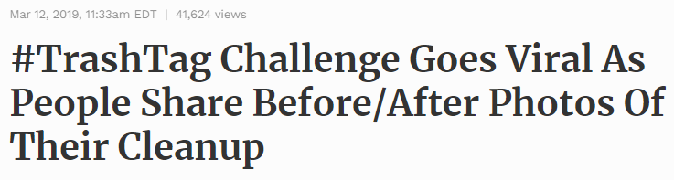
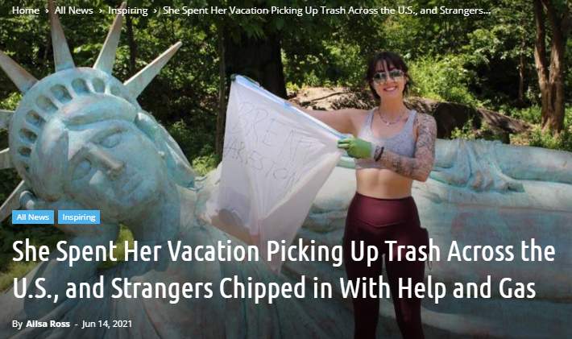
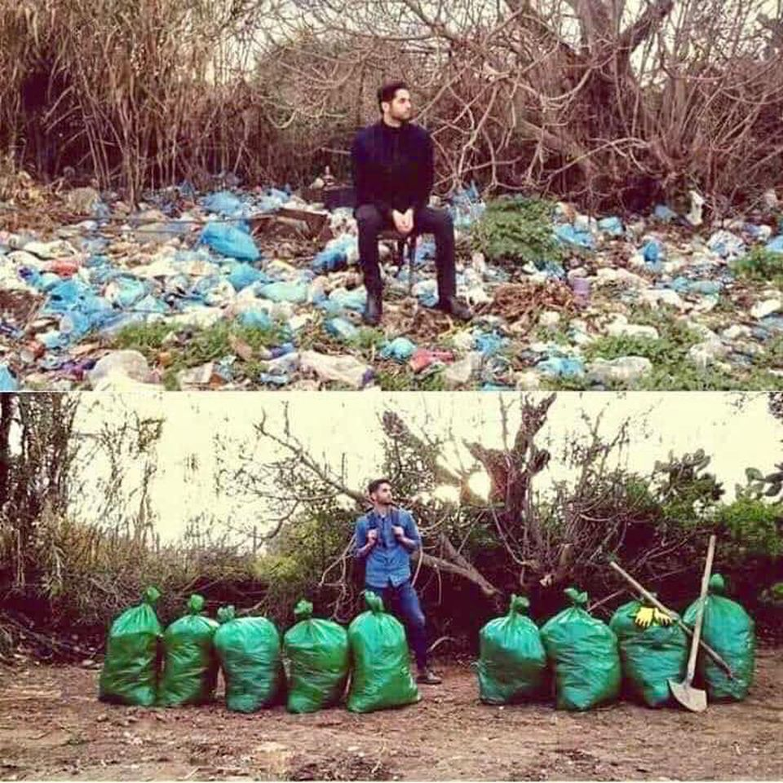

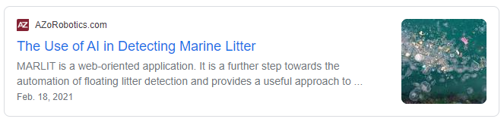
The
Desire for Change

Slide 4
Existing
Motivation
AI for Litter & Recycling Detection
Popularity of Cleanup Challenges
Corporate & Municipal Environmental Initiatives
What if we could:
Provide an AI based solution to propel momentum to clean up local landscapes while motivating users with rewards

Slide 5



cash the trash
$
Gamified Platform
Incentives
Community
Challenges

Slide 6
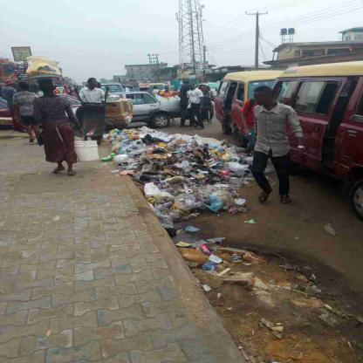
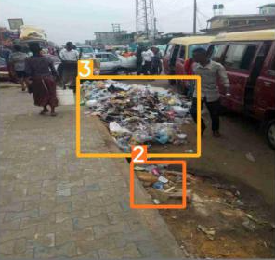

Our Dataset
0
No Litter
1
Low
2
Moderate
3
High
Original Image
Annotated Image
Text File for
Bounding Boxes
Our Model
[ 3 ]
High,
[ 2 ]
Moderate

Slide 7
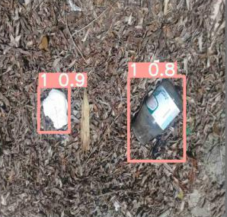
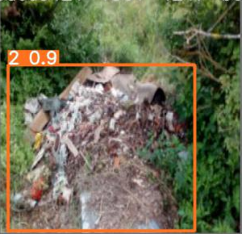
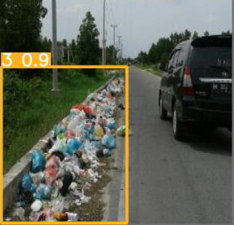
Our Models
CNN Classifier
R-CNN Object
Detector
Custom built CNN model to detect maximum level of trash in an image
Yolov5 pre-built object detection model uses bounding boxes to identify areas of trash and classify the amount
User Image
Prediction
Accuracy: 0.55
Overall Precision: 0.48 | Overall Recall: 0.49
[ 3 ]
High Litter Area

Slide 8
App Demo

Slide 9
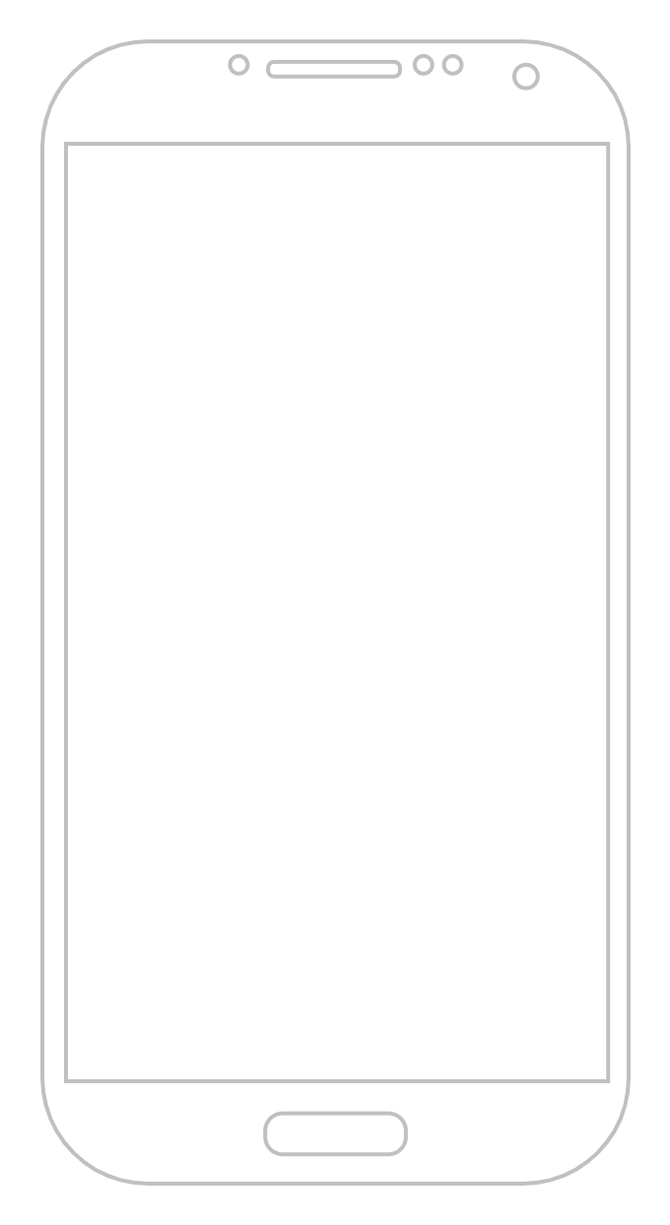
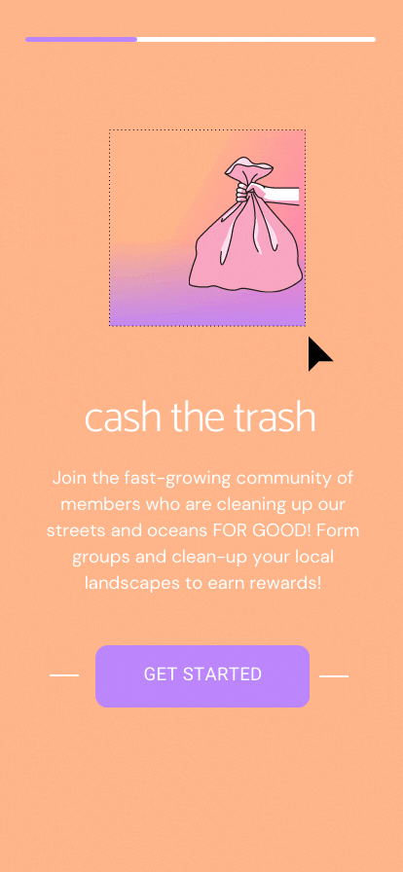

Slide 10





Users in Mind
Community Growth
Municipalities
Isolated
Individuals
Youth
Education
Corporate Initiatives
Funding Opportunities

Slide 11
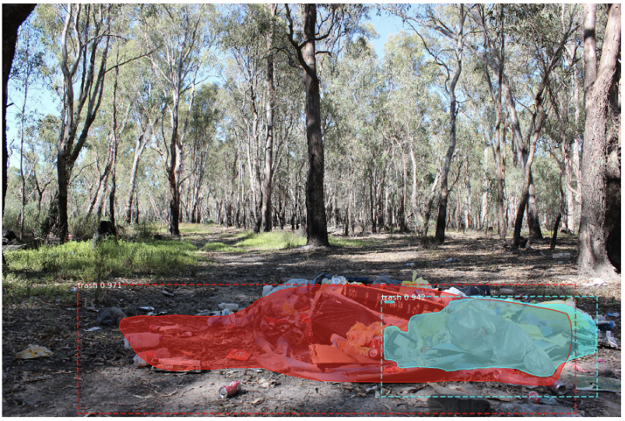
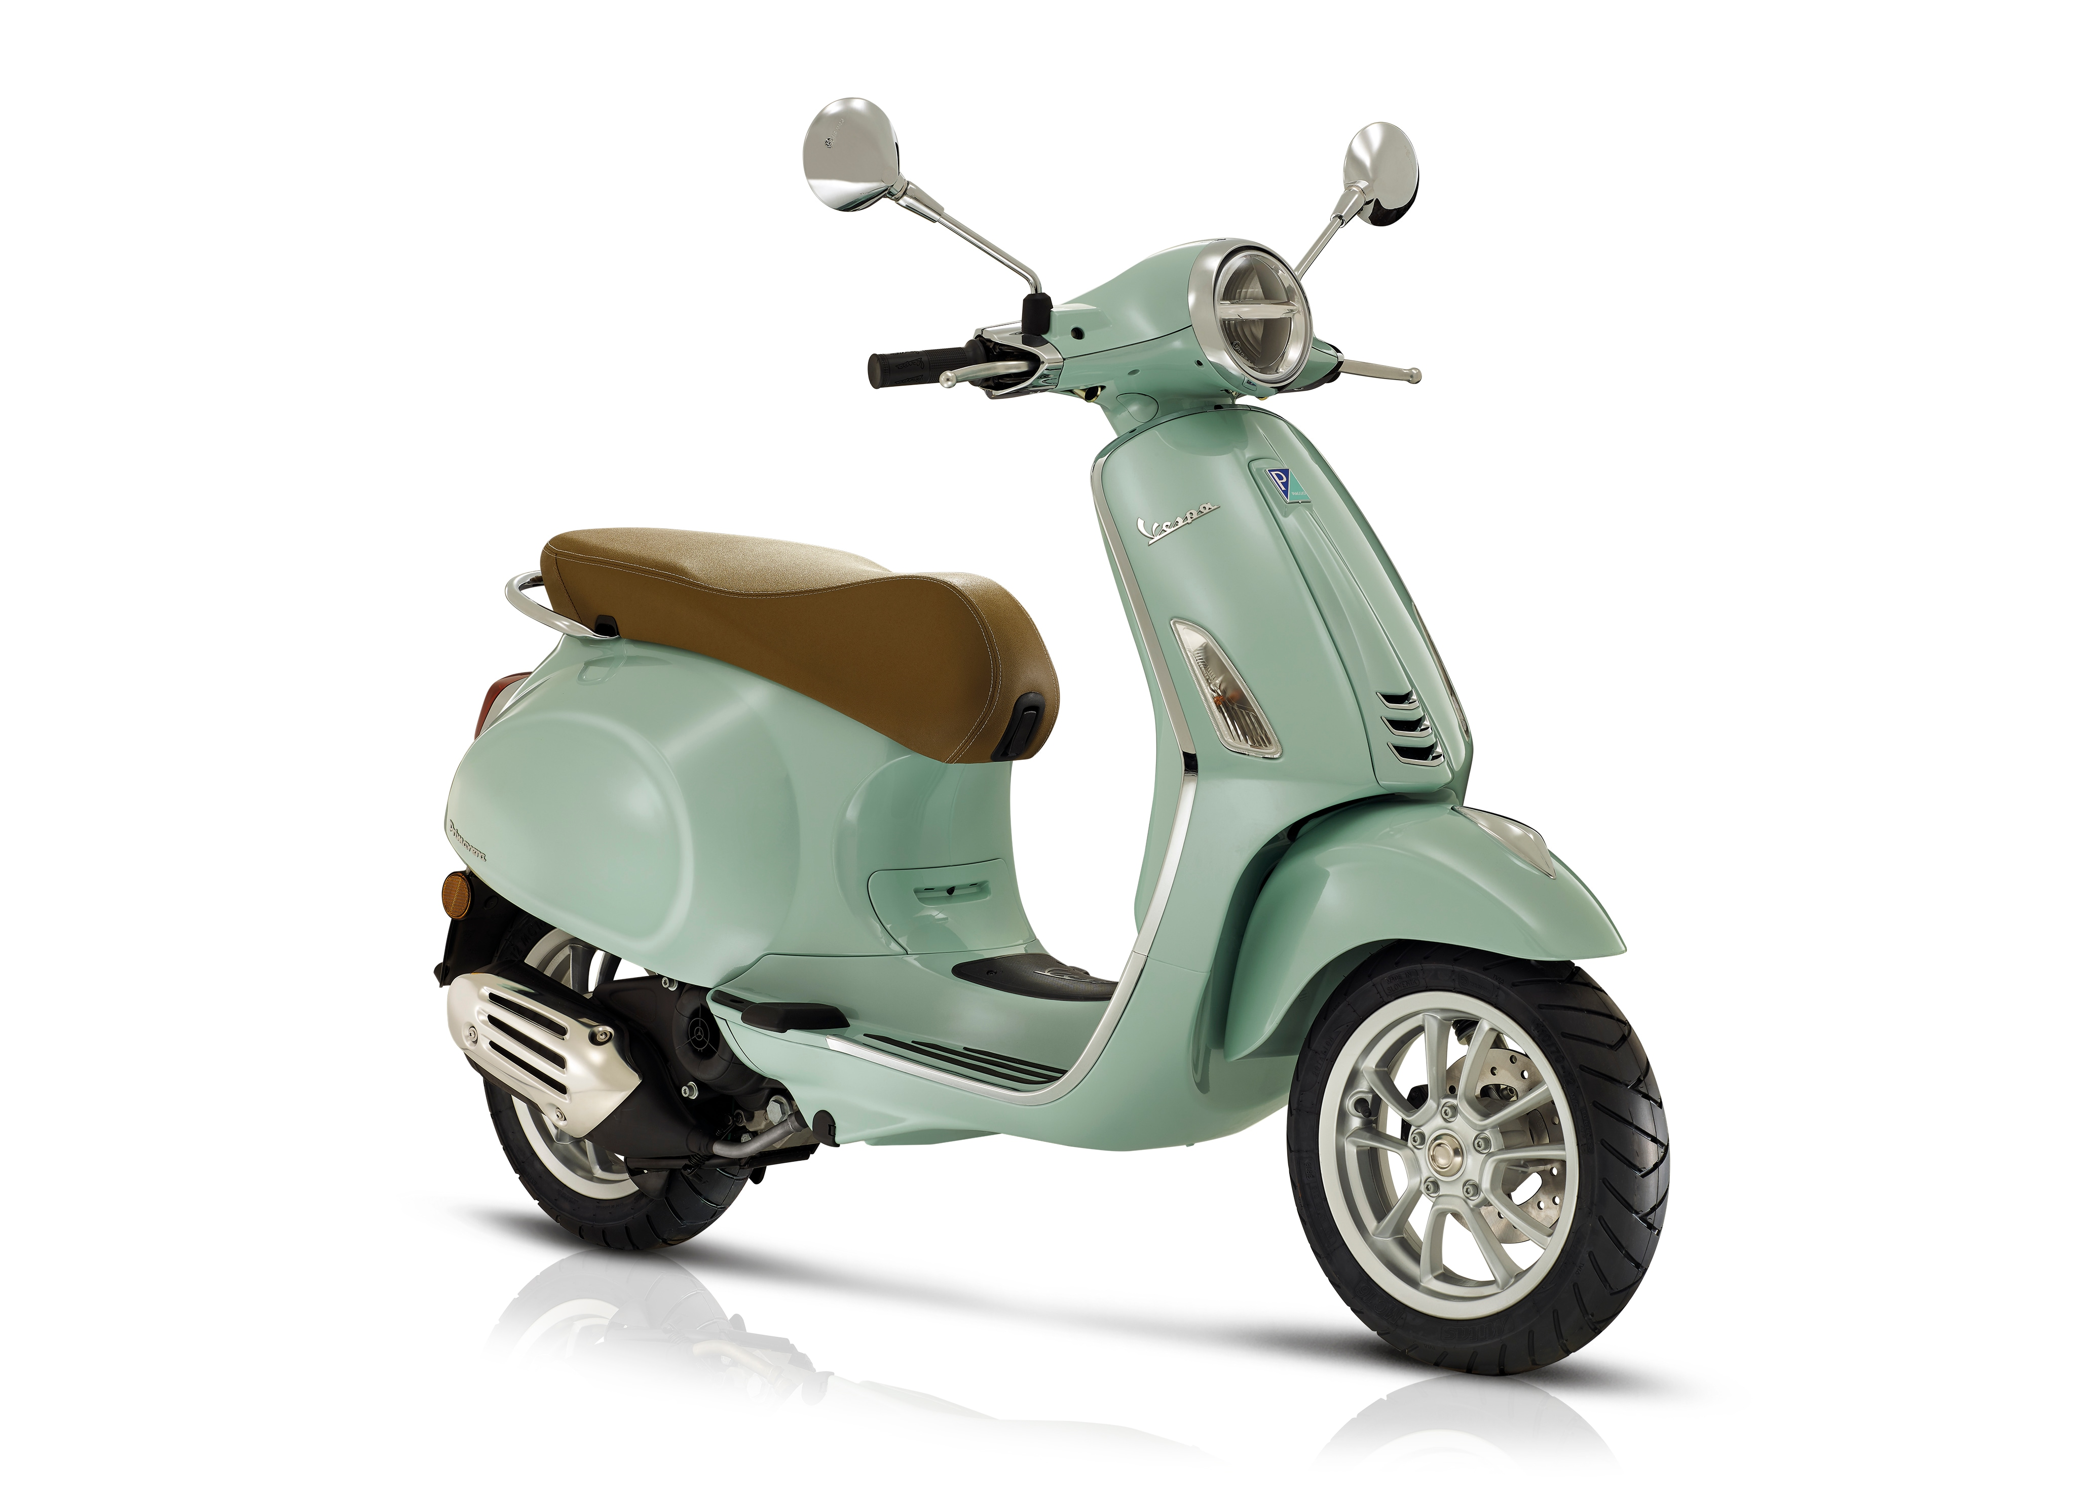



Competition
WadeAI
VespAI
Litterati
Detects Amount
Team-Based Activity
User friendly
Tangible Rewards

Slide 12






Next Steps
Improve our model through user data (feedbacks + images)
Gain funding to implement a user interface
Reach out to
organizations for the cashback/rewards program

Slide 13
Thank you to everyone who helped us!
Michael Buron Yuen – ODS Medical Inc
Tali Remennik – Accenture
Anju Tai – AltaML
Nastaran Gholizadeh
AI4Good Lab

Slide 14

“We do not inherit the Earth from our ancestors; we borrow it from our children.”
- Native American Proverb

